Slide 1
Social Media Report
October-2021
Notes:
Month at a glance
Web Stats – convert to 1 page
Social Results – convert to 1 page
Add page for TashRizzo: Omnichannel
Add Page for SUAS Linkedin Discussion

Slide 2

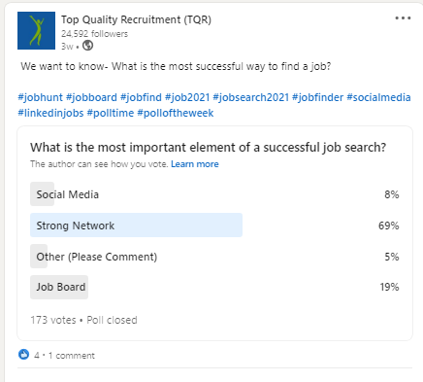


Top Posts for Oct 2021 LinkedIn
7,002
Impressions
183
Clicks
4
Reactions
2.97%
Engagement
6,411
Impressions
122
Clicks
8
Reactions
2.45%
Engagement
656
Impressions
47
Clicks
7
Reactions
12.69%
Engagement

Slide 3




Top Posts for October 2021 Facebook
6.2K
People Reached
47
Clicks
127
Engagement
3.1K
People Reached
9
Clicks
104
Engagement
3.0K
People Reached
9
Clicks
124
Engagement

Slide 4




Top Posts for October 2021 Facebook
1.3K
People Reached
16
Clicks
47
Engagement
1.3K
People Reached
2
Clicks
32
Engagement
1.3K
People Reached
0
Clicks
30
Engagement
3.0K
People Reached
11
Clicks
77
Engagement

Slide 5
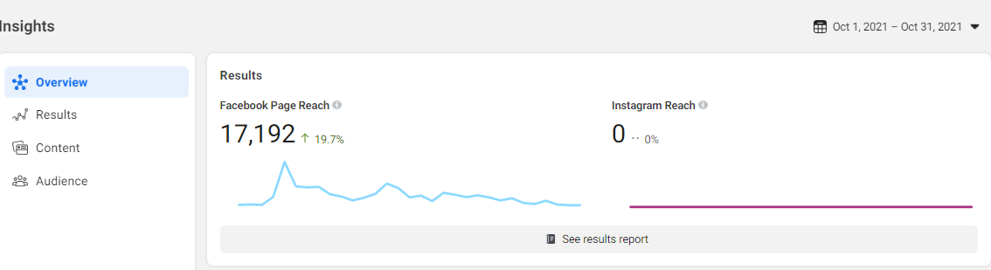
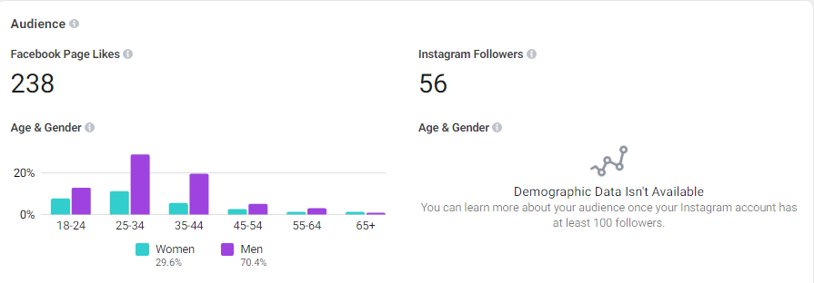
Facebook page insights

Slide 6

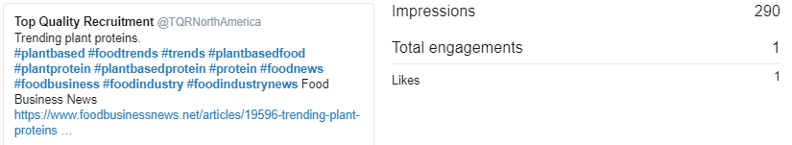
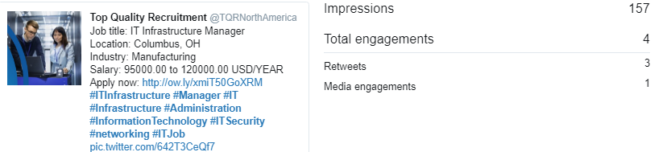
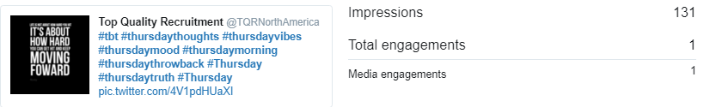
Top Posts for October 2021 Twitter

Slide 7
